Slide 1
Query Optimization Fundamentals
Improve uptime and performance through query-tuning strategies!
Edward Pollack
Microsoft Data Platform MVP

Slide 2
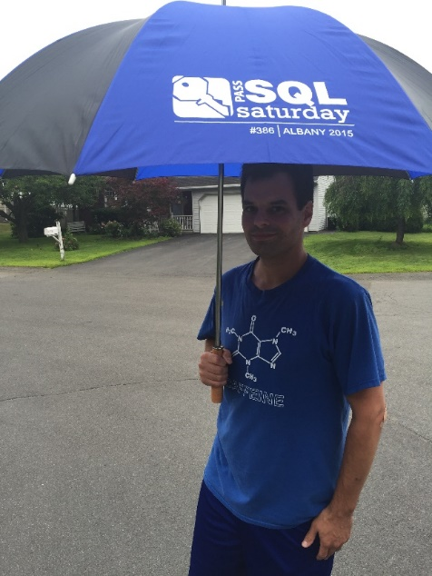




Ed Pollack
Microsoft Data Platform MVP
Published author of:
Dynamic SQL: Applications, Performance, and Security, 2nd Edition
Analytics Optimization with Columnstore Indexes in SQL Server
2nd edition released this year!
Expert Performance Indexing in SQL Server, 4th Edition
Published in Expert T-SQL Functions in SQL Server, 3rd Edition
Author on Simple Talk.
Organizes:
Day of Data Albany
SQL Saturday New York City
Capital Area SQL Server User Group
Speaker at many data events

Slide 3
Agenda
Why does query tuning matter in 2026?
Common application query problems (and solutions)
Best practices and guidelines
The future!

Slide 4
Why Does This Matter?
Can’t AI do this for me?
Can’t automation solve this?
Isn’t better hardware the solution?
Better app code can solve this, right?

Slide 5
Why Does This Matter?
App/DB Disconnect
Mismatched Standards
Can’t AI do this for me?
Can’t automation solve this?
Isn’t better hardware the solution?
Better app code can solve this, right?
Legacy Code
Business Logic
App Complexity
That Scary Cloud Bill!
Data Quality
Query Complexity
Domain Knowledge

Slide 6

Typical Workflow
User complains about poor app performance (IT’S SLOW!)
You are handed no details
Now what?

Slide 7
Basic Workflow for Success
Can the problem be reproduced?
YES ☺ → Profiler/Extended Events/DMV/Query Store/3rd party app
Get details!
NO ☹ → Logs to get query info or push back for more info!
Get the query text
Get resource metrics on query execution
CPU, memory, IO, etc…
Get SQL Server metrics on query execution
Duration, waits, locking, blocking, execution plan, etc…
Find the cause of latency and resolve

Slide 8

Identify a Query’s Purpose!
Optimization is hard without understanding a query
What is the query’s source?
How often is it executed?
Is the size/shape of the result set sensible?
Who/what is consuming the query output?
Is the thing even used!?

Slide 9
When Do We Stop Optimizing?
Further optimization is too expensive
Point of diminishing returns is reached
An alternate solution is identified
Not all optimization problems require database/query changes to solve!
Performance is now acceptable
Note: Optimal means “fast enough” - not as fast as possible!

Slide 10
Demo
Optimization Tools

Slide 11
Common Optimization Challenges (and Solutions!)

Slide 12
Indexing
Benefit: Indexes provide efficient table access for common queries.
Cost: Indexes must be written (IO/memory), stored, and backed up.
Do not index every query!
Do not blindly use recommended indexes!
Do not add INCLUDE columns unless needed.
Do check index usage periodically
Remove or tweak unused/underused indexes
Add critical missing indexes
Indexes improve read access at the cost of write speeds and storage.

Slide 13
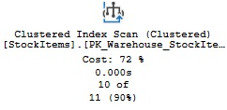
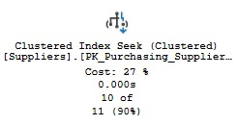
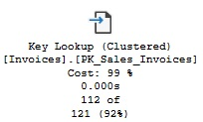
Execution Plan: Seeks, Scans, and Lookups
Scan = Read an entire table/index
Ideal when a large amount of data is needed*
Seek = Narrow search using an index
Best when filtering for a small data set.
Lookup = Need more columns
Good when an index gets performance to be sufficient, without adding more INCLUDE columns.
***Note: all columnstore index reads are logged as Columnstore Index Scans

Slide 14
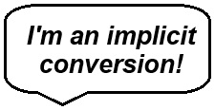
Data Types & Conversions
All data has a data type (!)
When columns of different types are compared…
…SQL Server will try to convert one to the other for you.
Microsoft documents this quite thoroughly.
For similar data types, this may be OK.
For different data types…
It may throw an error!
It may round/change the value of one column.
If a filter, then an unneeded scan may be forced on the converted column.

Slide 15
Demo
Implicit Conversions

Slide 16
Inefficient Joins & Filters
Filters should reduce data size quickly and efficiently.
Filter/Join columns should be clean and AVOID:
Functions
CAST/CONVERT
OR (this may be a sign of bad logic, too)
CASE
Leading wildcard/fuzzy searches
XML, JSON, or other non-relational complexity
Move those to a scalar or process elsewhere

Slide 17
Demo
Inefficient Joins & Filters

Slide 18
The SORT Operator
Sorting is one of the most expensive things a database engine can do.
Can be caused by:
DISTINCT
ORDER BY
ROW_NUMBER(ORDER BY)
Query against unindexed column
TOP
Sort in the application, not in the database.
Filter/join before sort → Sort on less data!

Slide 19
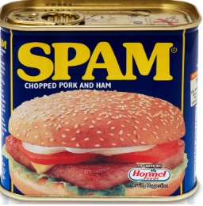
The Spammy Query
Sometimes, a query performs perfectly.
But it is run more often than makes sense!
Often a sign of an application bug or bad design.
Don’t tolerate spam!

Slide 20
Iteration
SQL Server is optimized for set-based operations.
Accessing a table repeatedly is less efficient than all-at-once.
100 rows in 1 query
<>
1 row at a time in 100 queries!
There is a balance between blocking and performance
***It is not subtle***

Slide 21
Demo
Iteration

Slide 22
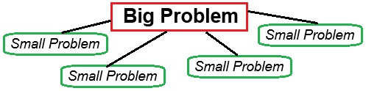
Query Complexity
The optimizer evaluates many combinations of tables, joins, operators, etc…
More tables/views/functions = more complexity
More chances to not get a good plan
Big problem? Break it into smaller problems!

Slide 23
Demo
Query Complexity

Slide 24

Nested Views/Functions/Triggers/Stored Procs
Encapsulation is not bad, but…
…nesting too many objects creates a lot of complexity
Hard to document
Objects are accessed too many times
Too much business logic in the database = bad
Objects calling objects calling objects calling objects calling objects calling objects calling

Slide 25
Nested Objects: Symptoms
Access against unexpected tables (or too much IO)
Larger execution plan than expected
Latency for a very small/simple query
Unexpected results
Higher row counts than anticipated

Slide 26
Demo
Nested Objects

Slide 27
Parameterization
Execution plan reuse is a very good thing
By default, we want all queries/procs to reuse plans whenever possible
Parameter sniffing is an outlier and not a norm. Do not architect around it. Do not cheat the optimizer.
Local variables incur a poor cardinality estimate as values are not known until runtime. Avoid when issues arise.
This problem is handled very poorly by the internet.
Want more? Check out my parameter sniffing presentation

Slide 28
Hacks and Quick Fixes
Best practices will guide us most of the time.
Outliers should be treated as case-by-case exceptions to best practices
Query hints
Plan forcing
Trace flags
Frequent adjustment of database/server features to non-defaults
Index spam
Awkward/temperamental tweaks (IN vs EXISTS, for example)
Hacks are acceptable to solve emergencies, but should not remain forever!

Slide 29
Conclusion
Efficient data access is critical to the success of an application
Our ability to do this is complicated by:
Business logic
Human error
Technical debt
Assumptions
AI can assist with many common issues…
…but falls short on complex/nuanced challenges…
or will provide MANY options for you to choose from
Optimization is a valuable skill that leads to better software!

Slide 30
Questions? Thank You!
Find me here:
Ed Pollack | LinkedIn
Edward Pollack | Most Valuable Professionals
https://sessionize.com/edward-pollack/
Find my content here:
EdwardPollack (Ed Pollack) (github.com)
Edward Pollack, Author at Simple Talk (red-gate.com)
Ed Pollack, Author at SQL Shack - articles about database auditing, server performance, data recovery, and more

